Slide 1
SAP BTP Architect Training
Day 2
Anubhav Oberoy
www.AnubhavTrainings.com
Follow excellence with sheer passion

Slide 2


DISCLAIMER
The training content and delivery of this presentation is confidential, and cannot be recorded, or copied and distributed to any third party, without the written consent of Anubhav Trainings

Slide 3
Agenda – Day 2
01
04
Using Olingo Framework to service OData Services
Introduction to Spring and Spring Boot
02
Create First Microservice using Spring
05
Add SAP UI5 Module with Java Application
03
VCAP Services & Connect to Postgres SQL
06
Deploy and Test End to end Java based application

Slide 4
Spring Framework
The Spring Framework provides a comprehensive programming and configuration model for modern Java-based enterprise applications - on any kind of deployment platform.
A key element of Spring is infrastructural support at the application level: Spring focuses on the "plumbing" of enterprise applications so that teams can focus on application-level business logic, without unnecessary ties to specific deployment environments.
The key advantage of spring framework are
Dependency Injection (Inversion of Control – IOC)
Light Weight
Loosely Coupled
Provides libraries for Runtime Environment
We can work with POJO (Pain Java Objects)
Testing (because we can change objects at runtime)

Slide 5
Spring Boot
Spring Boot is an Open-Source Java based framework which is used to create spring projects which are production ready.
Saves time
Provides all dependency
Developer can scaffold project types
Different options for deployment

Slide 6
Hands On – Spring Basics
Create a Simple Airplane application which allows to command flight operations to planes by replacing wings easily.
Bean
SpringBoot Application
Airplane
Fly()
IWings
Boing
Airbus
Solution:
Components

Slide 7
Hands-on Create First Microservice
Design a Microservice which returns data for different vendors.
Browser
ServletInitializer
Application
@RestController
VendorController
@Component
Vendor
Solution:

Slide 8
Use case – Real time Vendor Management
Design an Entity of Vendor and its address in the Spring boot app
Connect the application to the PostgreSQL in local system
Implement and test all CURDQ operations using REST API
Id
firstName
lastName
companyName
Website
emailId
gstNo
Vendor
Id
type
street
city
country
region
Address
1
*

Slide 9
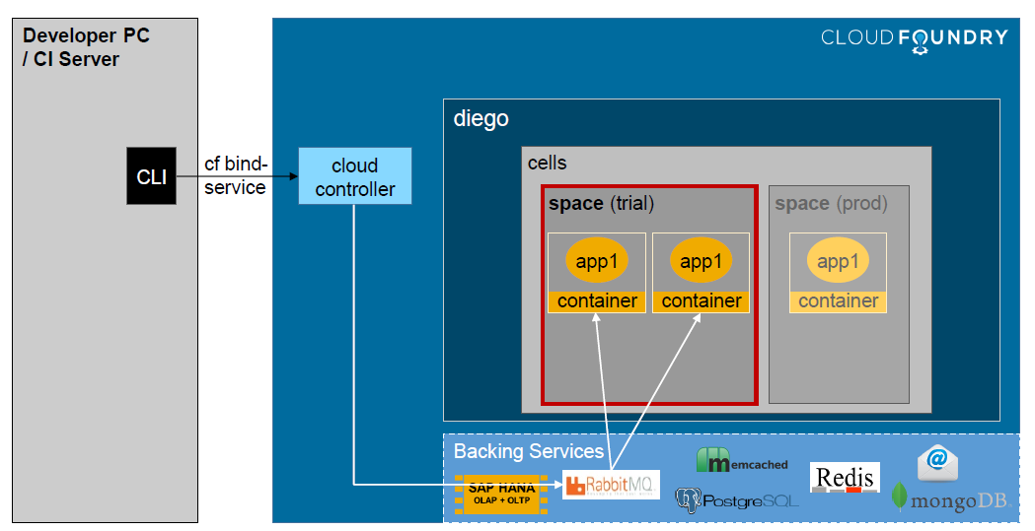
BTP App Connects to Backing service

Slide 10
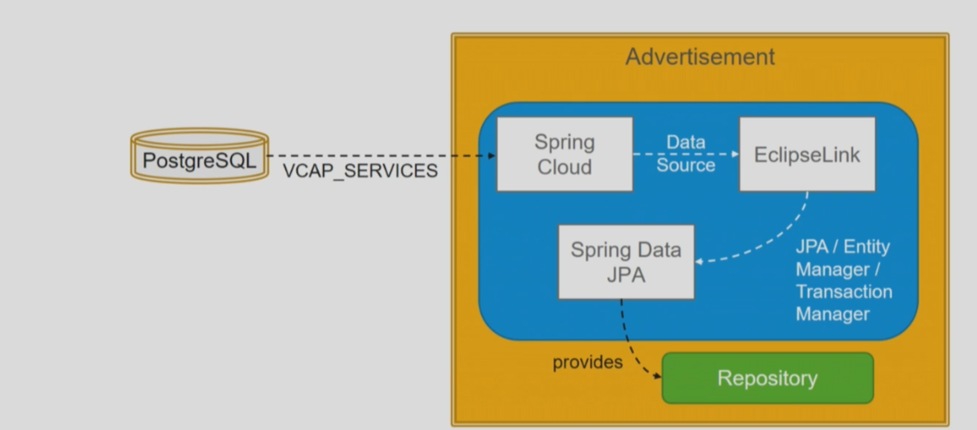
Postgres Backing Service

Slide 11

Backing Service
A backing service in CF is a reusable service, multiple instances of same app, or multiple app reuse this backing service. (remember car example Anubhav gave in earlier class)
DB as a service – PostgreSQL, Redis, HANA – Schema, HDI
Authentication – xsuaa
Connectivity service
Our application needs to bind at runtime to this backing service in order to consume it. As a developer you don’t need to worry for the binding because the CF container will automatically bind this backing service with our app and also create a service key while doing the binding.
We need to add the service name, inside manifest.yml file and specify the exact name inside services section.
Once the binding is complete, we can go and check the service key inside our cockpit.
We can also see the binded backing service details using CLI – cf env APP_NAME
Advantages
We never need to hardcode our DB credentials inside our app, these details will be provided by SERVICE key
We can also scale backing services independently
The complete management of backing service can be done through the cockpit or cli
System will also take care of AUTO binding with backing service in Q and P systems
The details of the credentials are provided by an environment variable called VCAP_SERVICES
www.anubhavtrainings.com

Slide 12
Title
7. Add new dependencies to our project
spring-cloud-cloudfoundry-connector
spring-cloud-spring-service-connector
ngdbc – HANA DB driver (we need it in future)
dbcp2 – it will control the flow of db calls from the app, and implements a implicit queue. Good for performance.
Eclipse Link JPA – this will take the object of cloud connection and pass this to our JPA classes (Entity manager, transaction manage)
Slf4j – it will be used for logging
8. We will now implement 2 classes which will be responsible for providing DB related objects to spring JPA (Earlier this work was done by spring itself by application.properties file)
8.1 Implement DatabaseConfig class as described abovem this class will use the variable extracted and provided to us to make a new database connection. This database connection we will pass to spring JPA. This class also create object of Entity Manager (DDL) and Transaction manager (DML)
8.1.1 Create DB connection using VCAP variable details
8.1.2 Create EntityManager by using the own DB connection
8.1.3 Create TransactionManager by using own connection
8.2 Entity Manager class which will have all the settings related to entity.
9. If needed, modify the settings in EntityManager class like we earlier did in properties file
10. Rebuild (by skip test) and deploy the app to sap btp
Looking the cloud foundry environment variable VCAP_SERVICES and parse it. Pass this information to a configuration class which we will register with spring. This class which inherits from AbstractCloudConfig class
EclipseLink which will then pass this information to our Spring framework
www.anubhavtrainings.com

Slide 13
Hands on: Project Structure – Spring JPA
CloudConfirg
Provide reusable code for all the controllers
API layer – Pre-checks, post checks, prepare payloads, validations, calculations
Interact with JPA persistence interface at runtime
JPARepository
/vendor
/address
Application
Pivotal Spring
Spring-JPA
Browser
@RestController
VendorController
AddressController
Service Module
@Component
VendorService
AddressService
IVendorRepository
Transaction Manager Factory
Postman
IAddressRepository
Entity Manager Factory
Database Connection
@Entity
Vendor
Solution:
application.properties
1..*
Address

Slide 14
Hands on: Adding Olingo for OData Service
There are frameworks available in market to develop OData using java. Apache is a company which provided an open-source framework called olingo. It allows us to develop end to end OData services. An odata service consists of end point registration, servelet, annotations, design time information, connection details, runtime information where we add the source code to performing CURDQ on our entity.
ODataServlet
ODataServiceFactory
MyODataAnnotation
@WebServlet
OData Servlet
URL Pattern
/anubhav.svc
MyODataServiceFactory
Purpose is to provide our class object
MyODataProcessor
Browser/postman
MyODataSource
ODataInterface
VendorODataAgent
AddressOdataAgent
SpringUtils

Slide 15
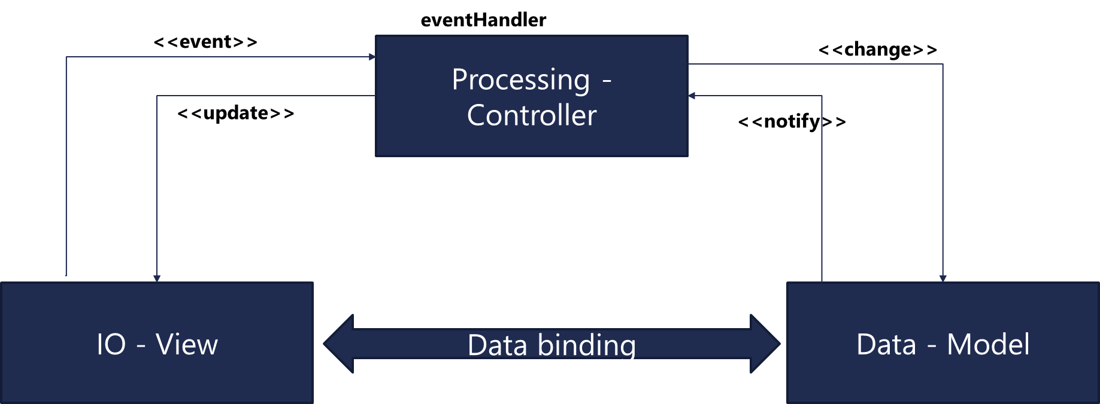
Hands on : Add UI Module
SAP UI5 is a framework to develop responsive web applications.
Framework – a collection of libraries
Library – a collection of classes
Class – collection of attributes, events, functions, aggregations
Responsive – An application which adapt itself according to the device
https://www.anubhavtrainings.com/ui5-and-odata-training
SAP UI5 SDK
https://sapui5.hana.ondemand.com/

Slide 16

Working with Git and Git HUB
We add the git repository and git staging views to VS tool
Created a first local repository
Right click on project and choose team->share project with repository
In git staging area we choose what are all the files I want to track and add them in staging area
Provide a meaningful message (purpose of the change), do the commit
We can check the commit id and branch name, right click on branch master, and choose show in – history
Like wise we can make multiple commits and any file we can right click and choose the reset to HEAD
----
Go to github, register and generate PAT
Right click on our repo, choose push
Entered the url of our gir repo
Add spec
Push
Entered our user id and PAT token
Branch - master
VS Code
project
proj
commit
proj
Local Repository
push
Git HUB

Slide 17
Title

Slide 18

What We Did
Let’s Summarize

Slide 19

www.anubhavtrainings.com
Thank You
End of Day 2

Slide 20


We’re committed to empower you to be
#FutureReady
through powerful training solutions.
We build the workforce of the future.
250+
Corporate Clients
30,000+
Learners Trained
25000+
Learners Placed
FREE WEBINARS
Sign up for free webinars with industry experts every fortnight!
Enroll Now!
Contact us today!
https://anubhavtrainings.com

